Slide 1
Mobile and Web Game UX
Course : Mobile and Web Game Programming
Effective Period : September 2018

Slide 2
These slides have been adapted from: Dr Penny de Byl. 2014. Holistic Mobile Game Development with Unity. FOCAL. Burlington. ISBN:978-0415839235 Chapter 3
Acknowledgement

Slide 3
Learning Objectives
LO 1 : Apply best practices of mobile and web game development
LO 2 : Apply game design and marketing techniques to boost mobile game performance
LO 3 : Produce game in mobile and web platform
LO 4 : Design game monetization and business model

Slide 4
Introduction
The challenges of mobile devices and interface development:
non-standard screen sizes
a variety of novel player–game interface methods
differing device screen resolutions
How the player will see the game?
Examine the design of user interfaces in mobile games.
Methods used to come up with good looking functional interfaces, and the main design rules.
Practical ways to ensure your game looks good
on any viewing device.

Slide 5
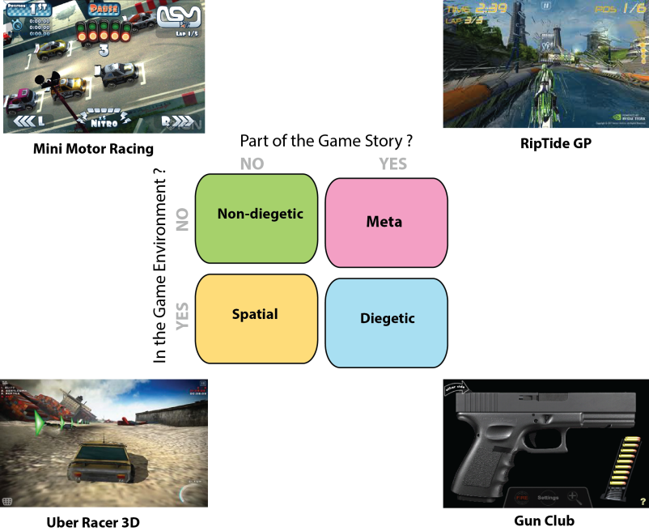
Graphical User Interfaces
Interface Types
Open your phone
Pick any game
In a piece of paper put your name and give a clear reason to why certain game UI is created.

Slide 6
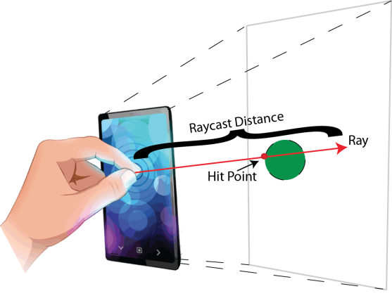
It Started with a Touch
Resistive and Capacitave
Status of Touch
Raycast

Slide 7
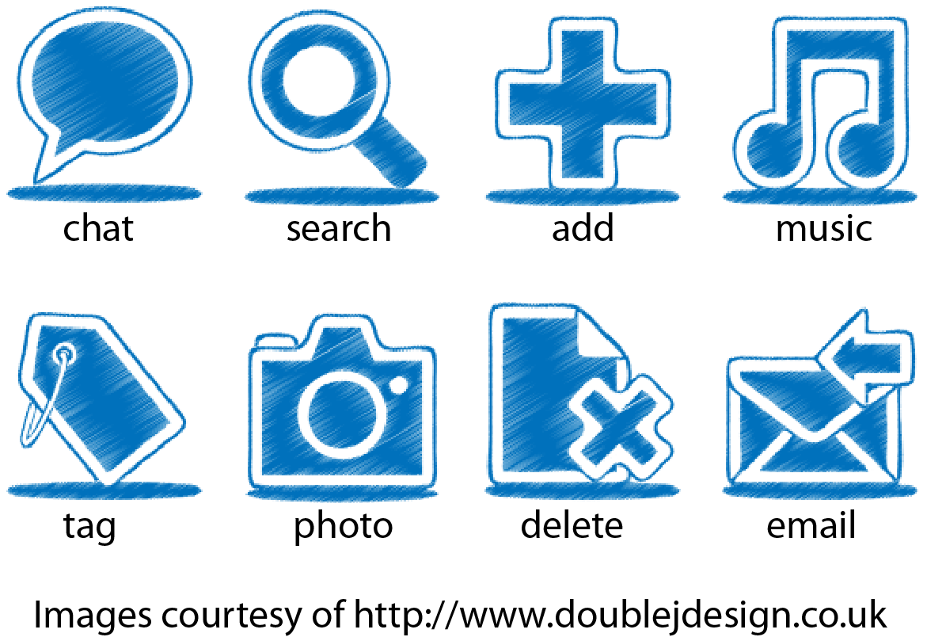
Principles of Mobile Game Interface Design
Control
Thumbsticks
Minecraft, Final Fantasy 3
State Visualization
Text and Animation
Metaphors

Slide 8
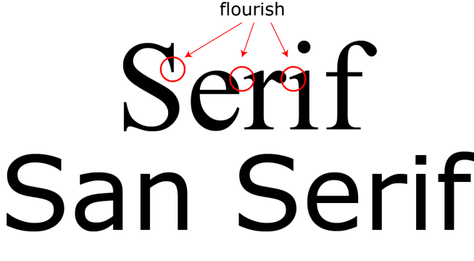
Principles of Mobile Game Interface Design
Sound
Feedback and Realism
Consistency and Coherence
Fonts and Buttons

Slide 9
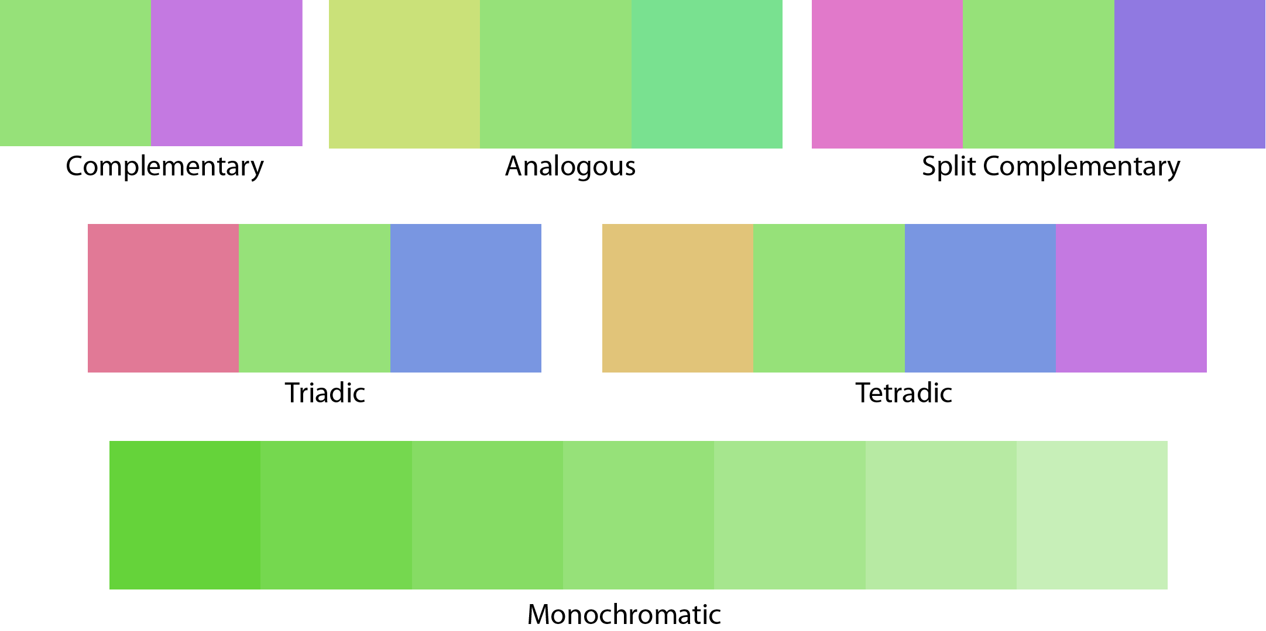
Principles of Mobile Game Interface Design
Color

Slide 10
Principles of Mobile Game Interface Design
Usability
Readable
Recognizable
Touchable

Slide 11
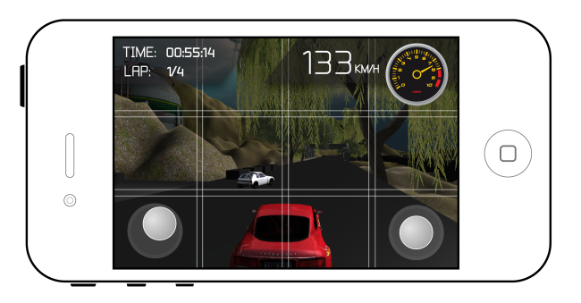
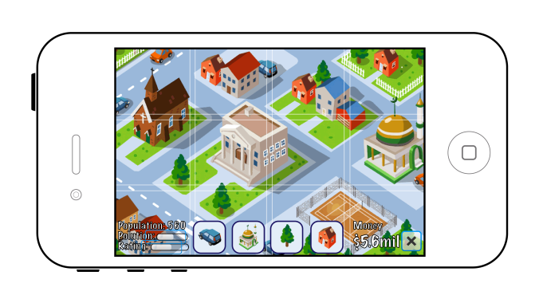
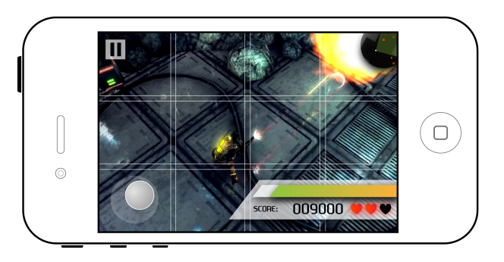
Principles of Mobile Game Interface Design
Layout
Nature of the game

Slide 12
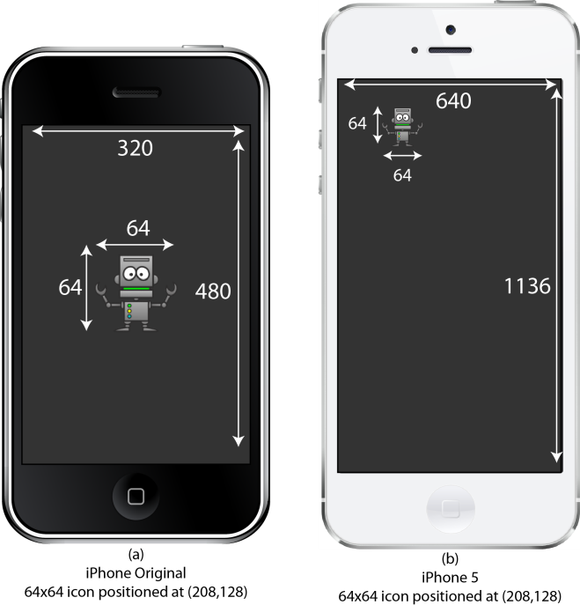
Principles of Mobile Game Interface Design
Layout
Alignment and Proximity
Cognitive Load

Slide 13
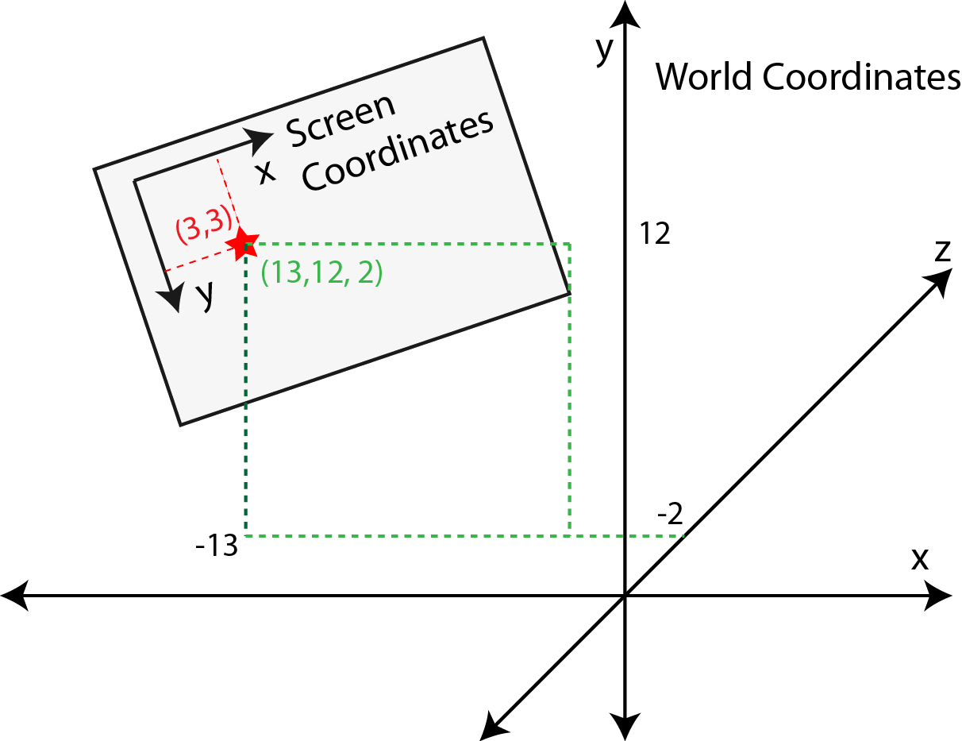
Unity GUI in a Nutshell
2D coordinate system in a 3D world space

Slide 14
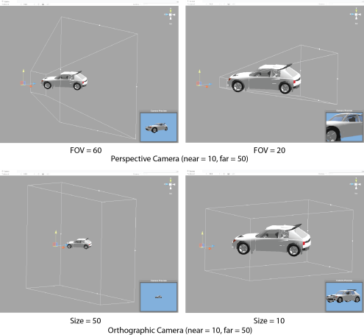
Screen to World Space
Camera Projections
Perspective or Orthographic
Frustum
Viewing volume
Field of View
Exploring Screen and World Space by Touch

Slide 15
Swipe, Shout and Shake it All About!
Pinch
Zoom in and Zoom out
Swiping
Extend and Switch

Slide 16
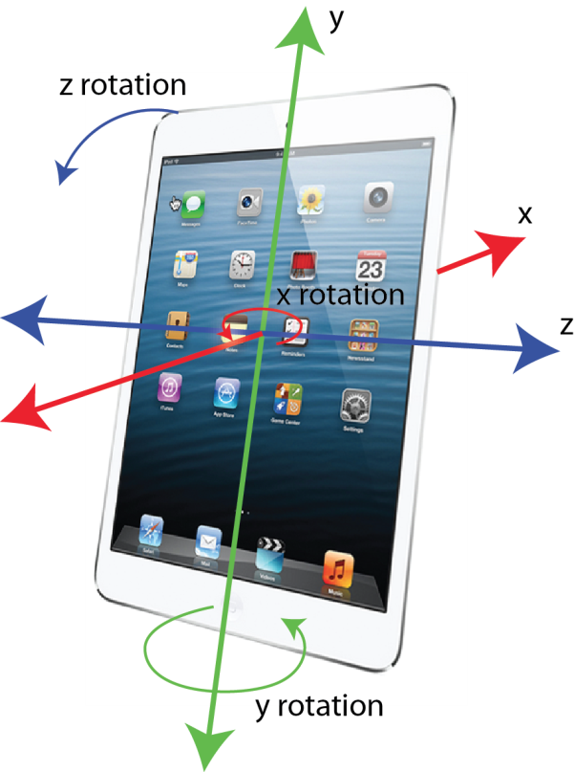
Swipe, Shout and Shake it All About!
Tilt and Acceleration
Accelerometers

Slide 17
Swipe, Shout and Shake it All About!
Orientation
Global Positioning Systems (GPS) and Compasses
Trilaterate
Magnetometer

Slide 18
Joysticks
Consol controllers
Double joysticks
Movement
Orientation

Slide 19
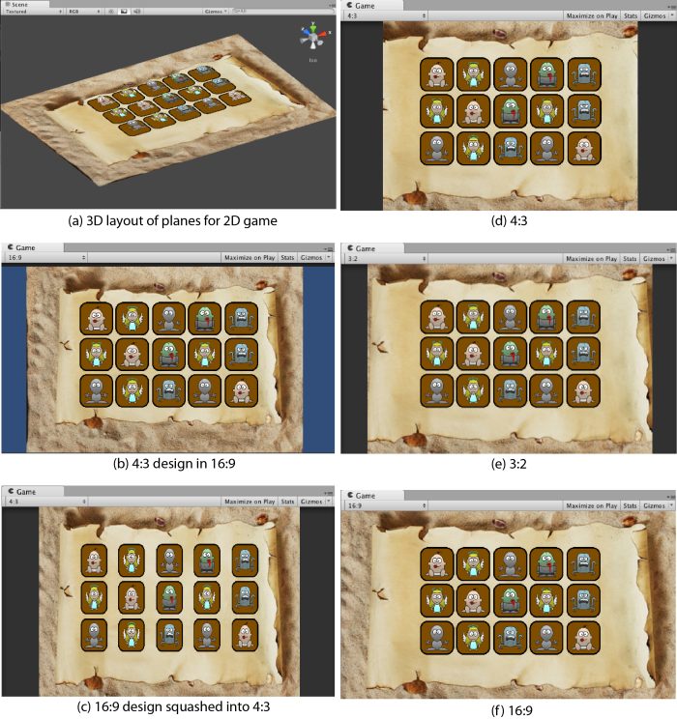
Handling Multiple Resolutions
Aspect Ratios
Common area
Camera’s near plane size widens or shortens
Shorter aspect stretches to fill
Top and bottom fixed, restrict sides

Slide 20
Handling Multiple Resolutions
Resolution and the Graphical User Interface
Scaling the GUI matrix
Using screen resolution to control camera
(Listing 3.4,
pp. 192-193)

Slide 21
Design Your First Mobile Game…
Open your phone again
Pick a game
Clone it with IMPROVEMENT
Put it all in a piece of paper !!!

Slide 22
Summary
Mobile Game Interfaces
Interface design is a critical factor in the success of your mobile game.
Interface design should be integrated as an essential design element from the outset.
The theme of the GUI must emulate the theme of the game.
The type of experience you want for your player will impact on your design; a rich immersive 3D world calls for a diegetic design that draws the player in and supports their suspension of disbelief, and or a god-like control of proceedings would suggest a non-diegetic interface.
The interface is the games communication channel
with the player.

Slide 23
References
Dr Penny de Byl. 2014. Holistic Mobile Game Development with Unity. FOCAL. Burlington. ISBN:978-0415839235

